Slide 1
Stock Analysis Package: A Comprehensive Tool for Financial Analysis
Shubham Narkhede,
Subham Moda,
Yanyun Wang,
Xinran Liu,
Zixin Zhou,
Course- FE 520
Under the Guidance of
Prof. Zin Chen

Slide 2
Introduction
The Stock Analysis Package is a Python-based tool designed for comprehensive financial analysis.
It utilizing the yfinance library (Reference: yf.Ticker) to get the current market data.
Developed with a focus on empowering users to make informed investment decisions.
The package aims to facilitate stock market analysis by providing tools for data fetching, visualization, and advanced technical analysis. It empowers users to make informed decisions based on historical stock trends.

Slide 3
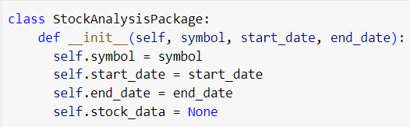
Overview of the Stock Analysis Package
The package provides a suite of features to aid in financial analysis, including data fetching, candlestick visualization, moving averages, MACD analysis, Bollinger Bands, and RSI.
Key Features:
Data Fetching:
fetch_stock_data method, which validates the stock symbol, date range, and ensures equity nature (Reference: quoteType).
Candlestick Visualization:
visualize_candlestick method using Plotly for interactive candlestick charts.

Slide 4
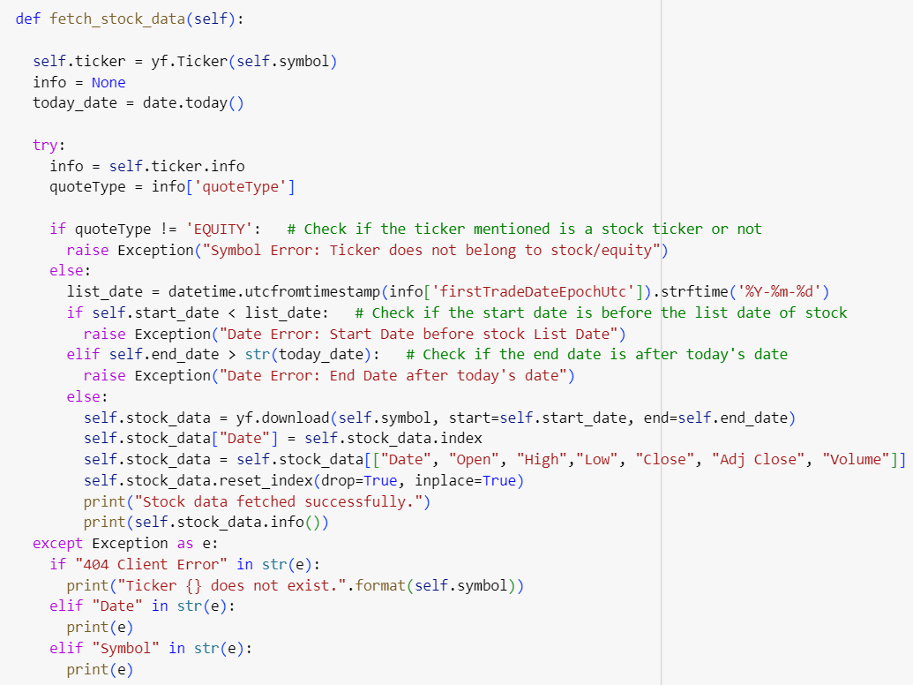
Data Fetching
The fetch_stock_data method ensures reliable data retrieval:
Validates the stock symbol and date range.
Verifies that the provided stock symbol belongs to an equity (Reference: quoteType).
Checks if the date range is within the stock's listing date and before the current date.

Slide 5
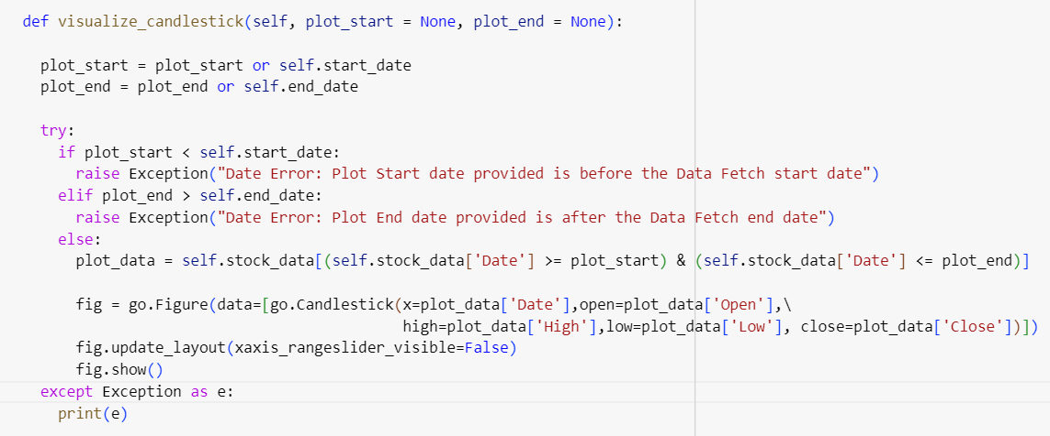
Candlestick Visualization
The visualize_candlestick method utilizes Plotly to create interactive candlestick charts.
Ensures focused analysis within a specified date range.

Slide 6
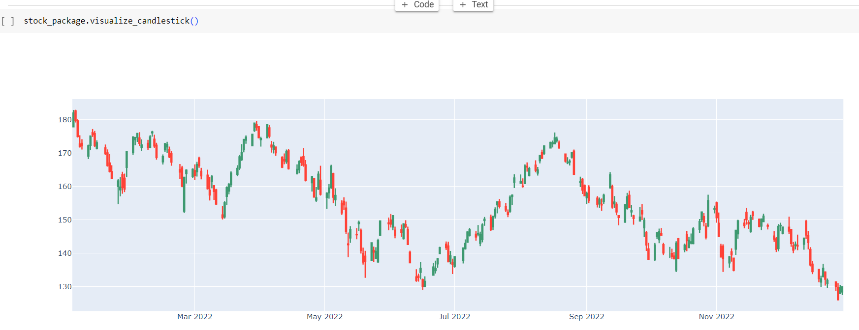
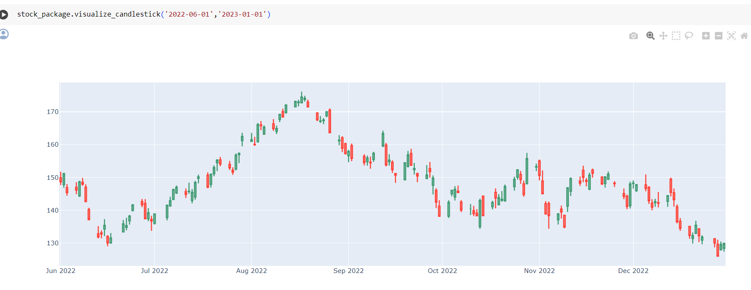
Candlestick Visualization

Slide 7
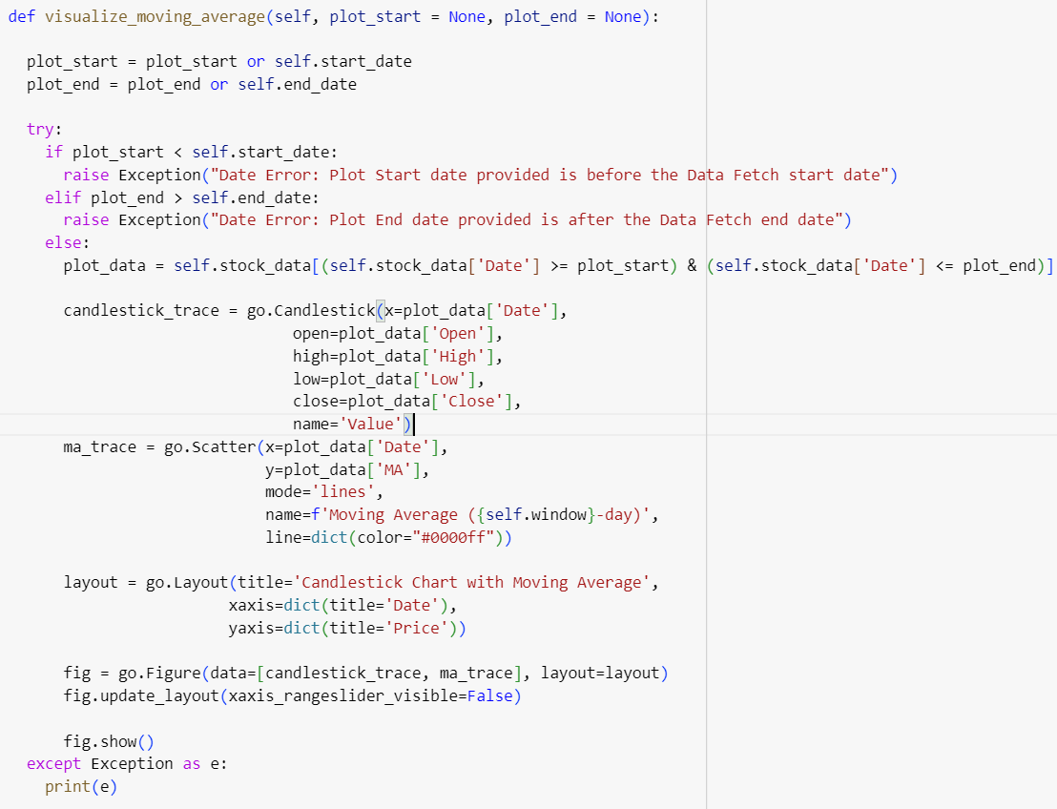
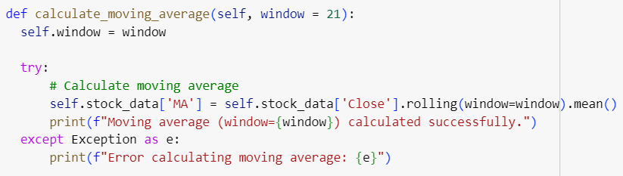
Moving Averages
The calculate_moving_average method computes a smoothed representation of price trends using a specified window.
The visualize_moving_average method combines candlestick charts with moving averages for comprehensive analysis.

Slide 8
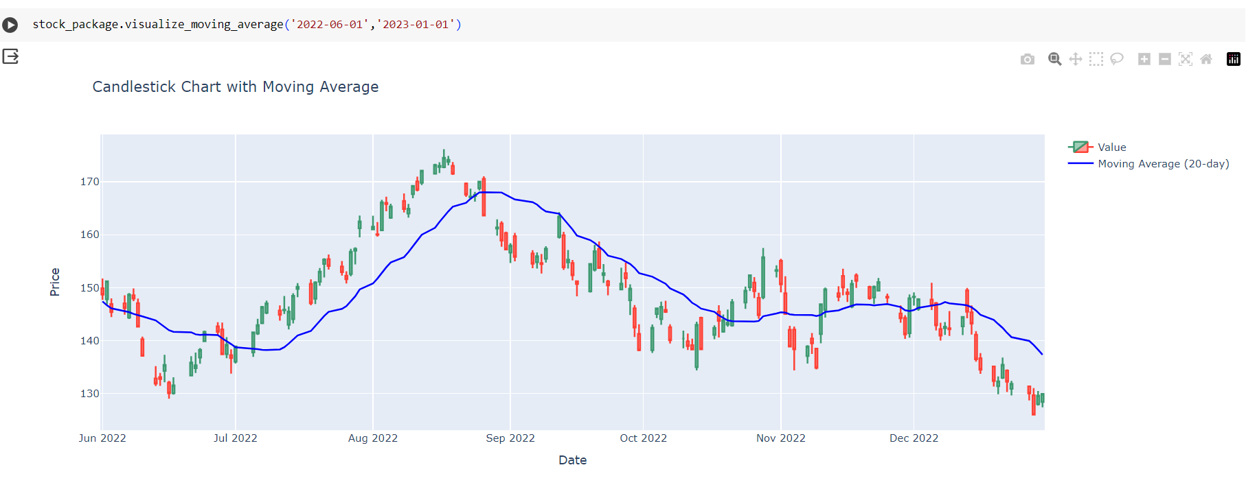
Moving Averages

Slide 9
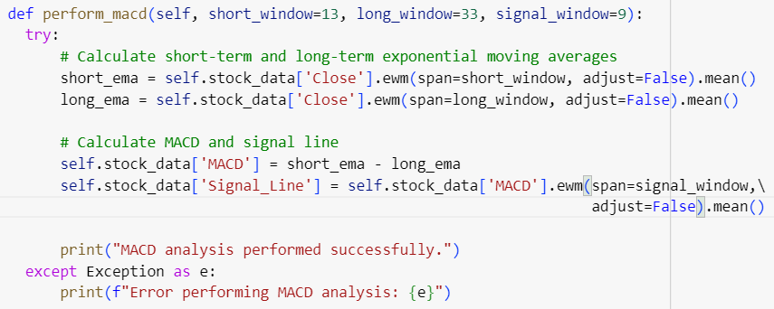
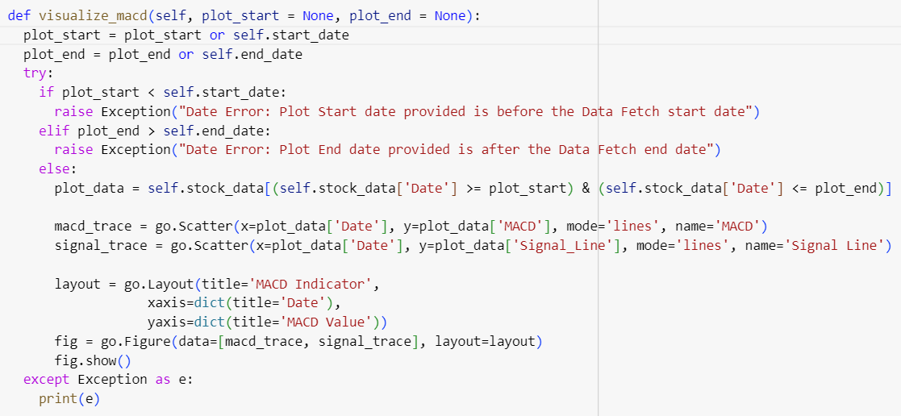
MACD Analysis
The perform_macd method calculates short-term and long-term exponential moving averages (EMAs).
The visualize_macd and visualize_macd_histogram methods provide visual representations of MACD and its histogram.

Slide 10
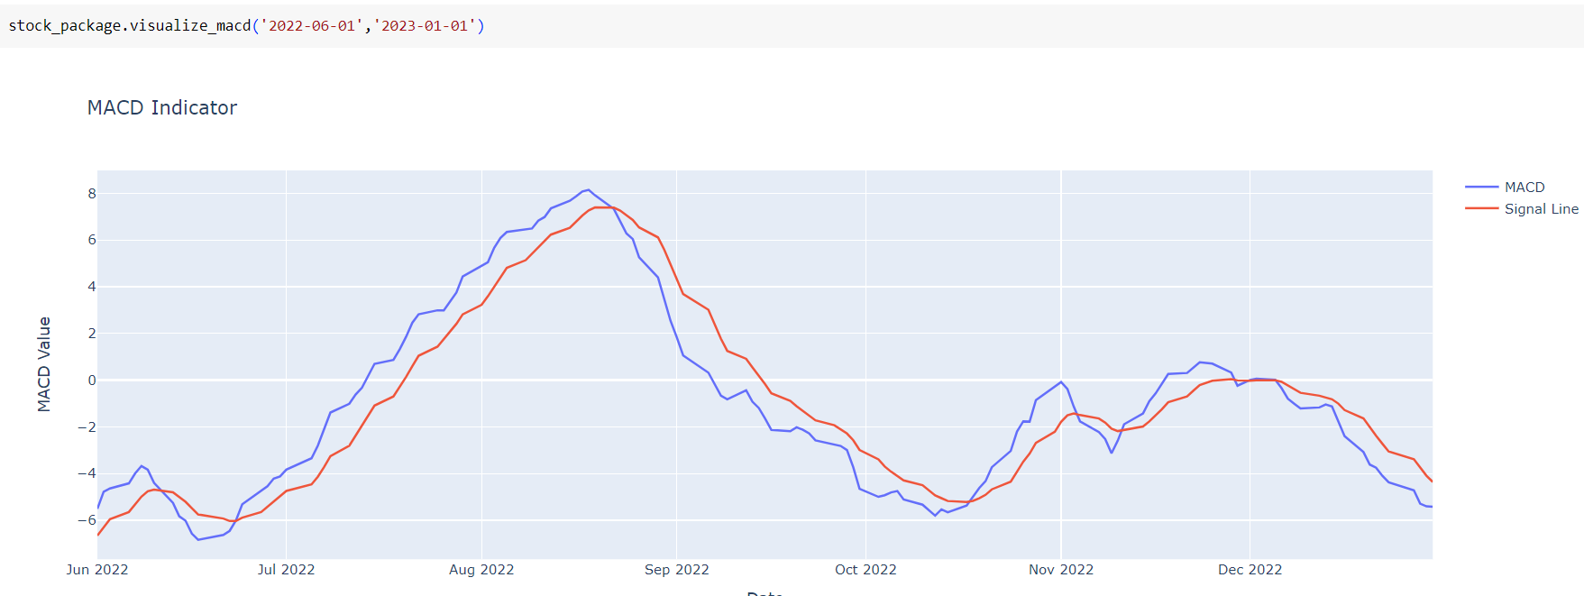
MACD Analysis

Slide 11
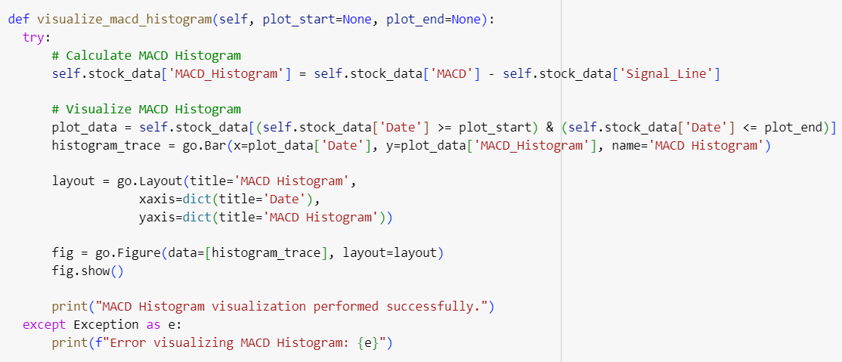
MACD Analysis Histogram
The perform_macd_histogram method calculates plots the histogram plot of the moving averages (EMAs) which helps in better visualization.

Slide 12
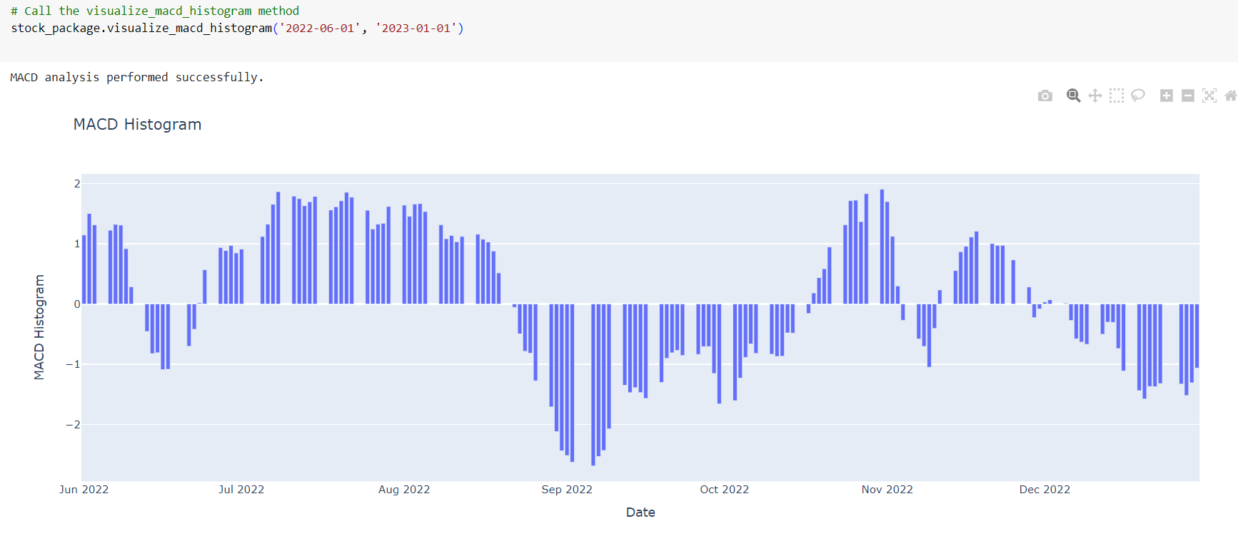
MACD Analysis Histogram

Slide 13
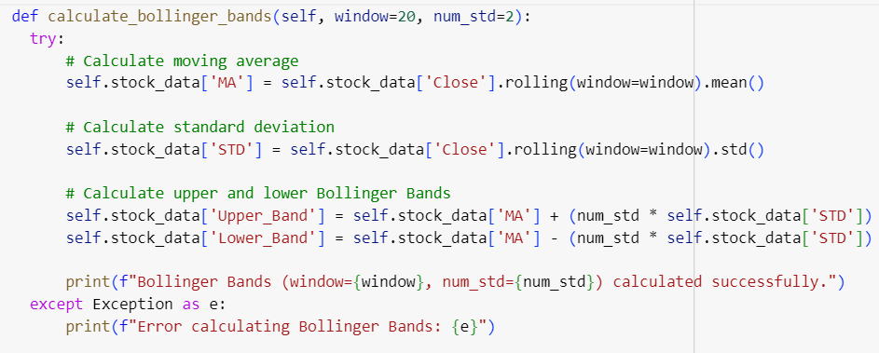
Bollinger Bands
The calculate_bollinger_bands method computes moving averages, standard deviations, and upper/lower Bollinger Bands for identifying potential reversals and volatility changes.
The visualize_bollinger_bands method combines Bollinger Bands with candlestick charts for comprehensive analysis.

Slide 14
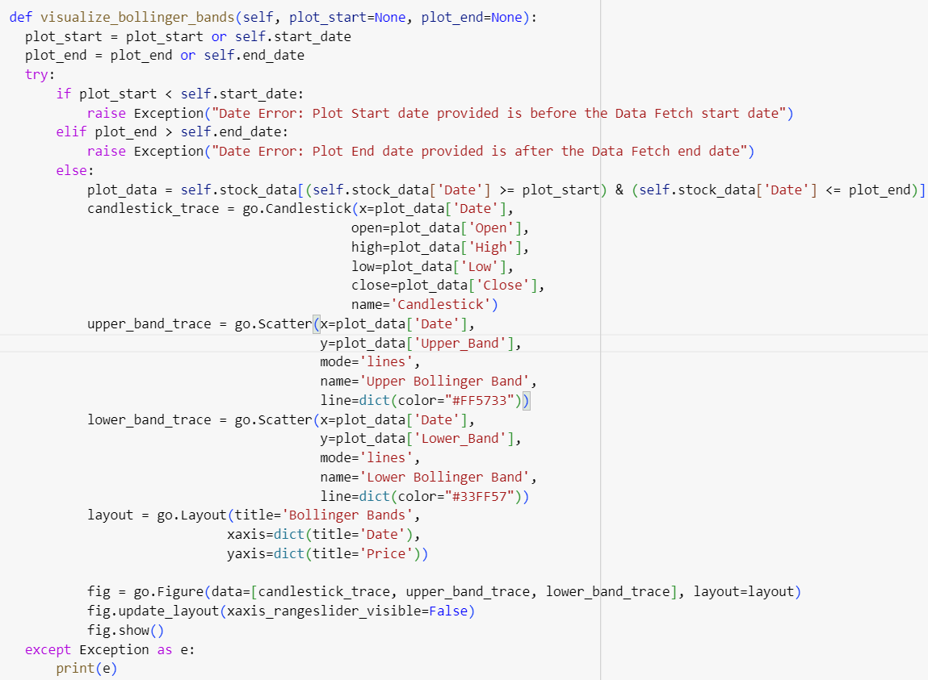
Bollinger Bands Visualization
The visualize_bollinger_bands function dynamically creates an interactive Plotly chart.
Integrating candlestick patterns with upper and lower Bollinger Bands for insightful market trend analysis.
Ensures user-defined date ranges are valid and appropriately handles errors for a seamless analytical experience.

Slide 15
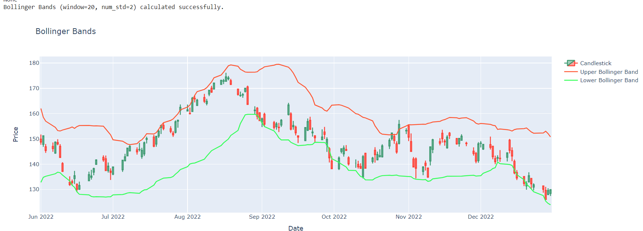
Bollinger Bands Visualization

Slide 16
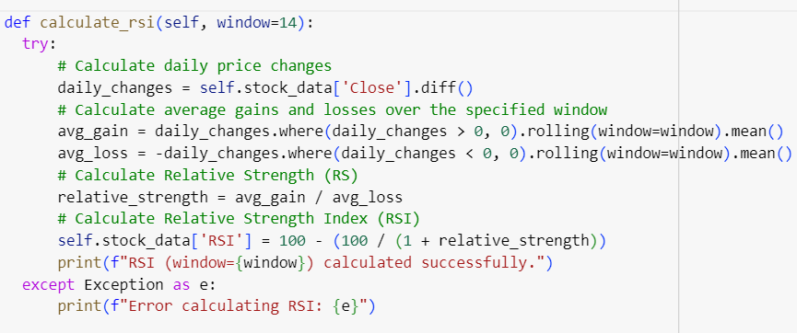
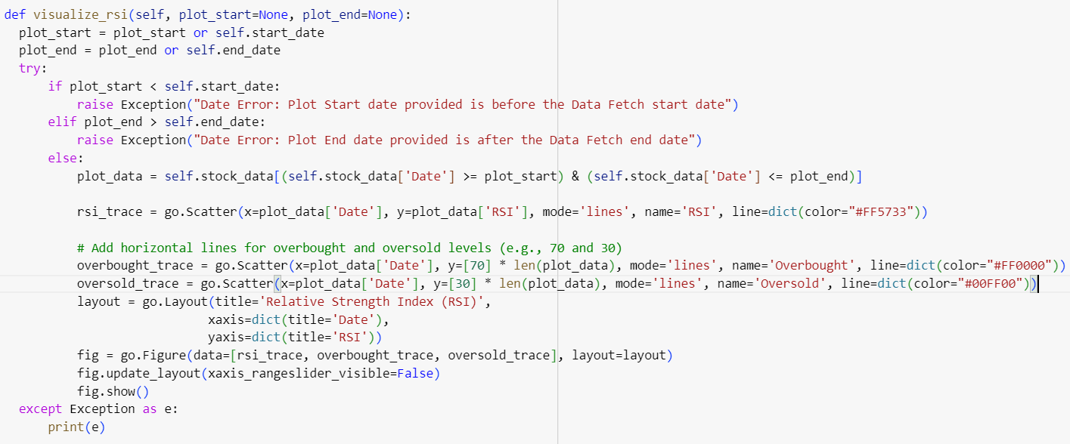
RSI (Relative Strength Index)
The calculate_rsi method computes the Relative Strength Index (RSI) to measure the speed and change of price movements.
The visualize_rsi method provides visual representations of RSI with overbought and oversold levels.

Slide 17
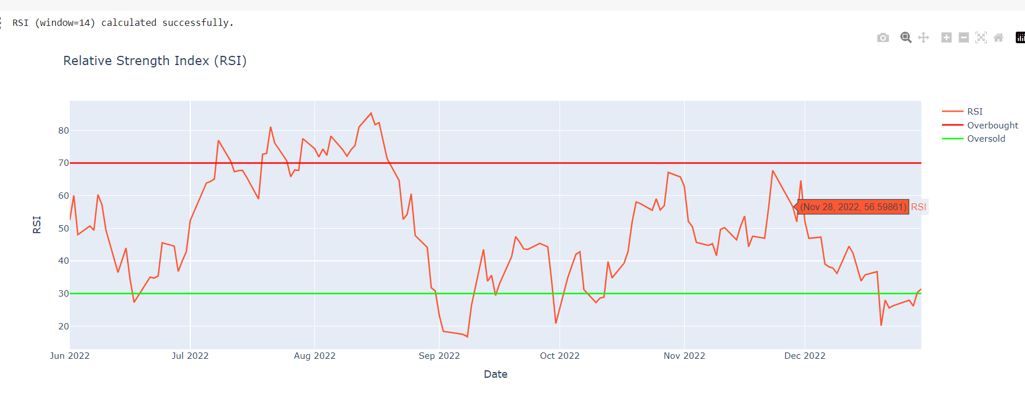
RSI (Relative Strength Index)

Slide 18
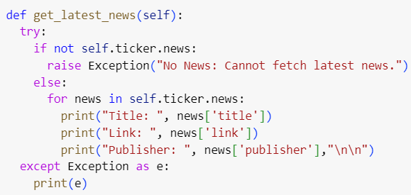
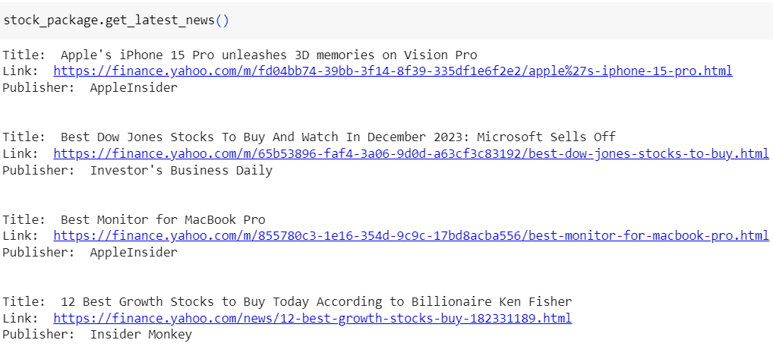
Latest News
The get_latest_news function leverages the Yahoo Finance API to fetch the latest news related to the stock.
Displays the title, link, and publisher for each news article, providing a comprehensive overview.
Robust error handling ensures a smooth user experience even when no news is available for the specified stock.

Slide 19
Benefits of Using the Stock Analysis Package
Comprehensive Analysis: The package offers a wide range of analytical tools.
User-Friendly Interface: Easy-to-use methods for fetching data and visualizing results.
Interactive Visualizations: Plotly-based charts enhance the user experience.
Error Handling: Robust error handling ensures reliable performance

Slide 20
Conclusion
In conclusion, the Stock Analysis Package presented here offers a robust and versatile toolkit for in-depth analysis of stock market data. This comprehensive package is designed to empower users with key insights into a stock's performance, employing various technical indicators and visualizations.
Let's summarize the key points:
Data Fetching and Validation
Visualization Tools
visualize_moving_average ,visualize_macd and visualize_macd_histogram showcase the MACD indicator and its histogram for insightful trend reversal signals.
visualize_bollinger_bands into the candlestick chart, facilitating volatility analysis.
visualize_rsi displays the Relative Strength Index (RSI)
Technical Analysis: computes the moving average, a fundamental indicator for trend identification. perform_macd computes the Moving Average Convergence Divergence (MACD) and its signal line.calculates Bollinger Bands, adding a volatility dimension to the analysis. calculate_rsi computes the Relative Strength Index (RSI), aiding in identifying potential reversal points.
Latest News Integration:fetches and presents the latest news related to the specified stock.
User-Friendly Exception Handling: Exception handling throughout the package ensures user-friendly error messages, enhancing the overall user experience.

Slide 21
Contribution
Members' Contributions
Shubham Narkhede - (Role: Project Lead)
Package setup, adding required packages.
Main class initialization function and calls of class functions.
Data fetching function.
Implementation of exception and error handling in all sections of the package.
MACD Histogram visualization function (`visualize_macd_histogram`).
Subham Moda - (Role: Visualization Specialist)
Candlestick visualization function (`visualize_candlestick`).
Moving average calculation function (`calculate_moving_average`).
Moving average visualization function (`visualize_moving_average`).
Error handling as required.
Xinran Liu - (Role: Technical Analyst)
MACD calculation function (`perform_macd`).
MACD visualization function (`visualize_macd`).
Documentation
Zixin Zhou - (Role: Volatility Analyst)
Bollinger Bands calculation function (`calculate_bollinger_bands`).
Bollinger Bands visualization function (`visualize_bollinger_bands`).
Documentation
Yanyun Wang- (Role: Momentum Analyst)
Relative Strength Index (RSI) calculation function (`calculate_rsi`).
RSI visualization function (`visualize_rsi`).
Latest news fetching function (`get_latest_news`).
Function calls of all the feature of the Package
Overall Collaboration - Code Development:
Each team member contributed to the development of various functions, ensuring efficiency and error-free implementation.
Testing: Rigorous testing was conducted to identify and rectify bugs, ensuring the reliability of the package.

Slide 22
THANK YOU
Stevens Institute of Technology
1 Castle Point Terrace, Hoboken, NJ 07030

